Slide 1
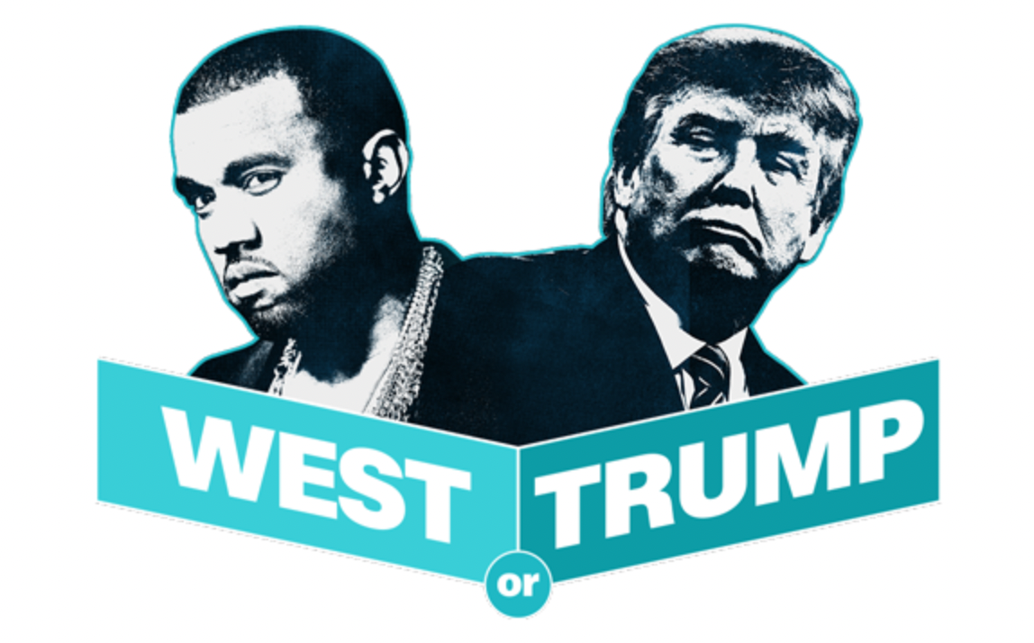
T1A3 Ruby app
Sarah Cahill

Slide 2
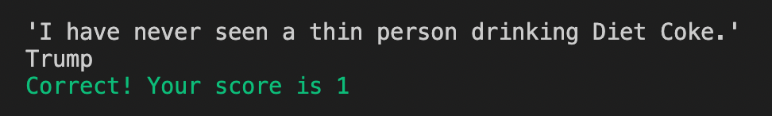
What is it?
A simple 15 question quiz, where users are asked to identify the author of given tweets – Donald Trump or Kanye West

Slide 3
Features
Asks user for name input, uses it throughout quiz.
Users are presented with a tweet and asked to type who said it.
If user answers question correctly, they are told their cumulative score.
If user answers question incorrectly, they are told they got the question wrong.
User is presented with score at end, with three options as to how they did:
👏 – if they got more than half the questions right
👍 – if they got more than one but less than half the questions right
😳 – if they got no questions right
User has options to gamble all points at end – if they get the last question right, their points are doubled. If they get it wrong, they lose everything. Final score is then presented.
Colour is used to differentiate questions and scores, and to improve UX.

Slide 4
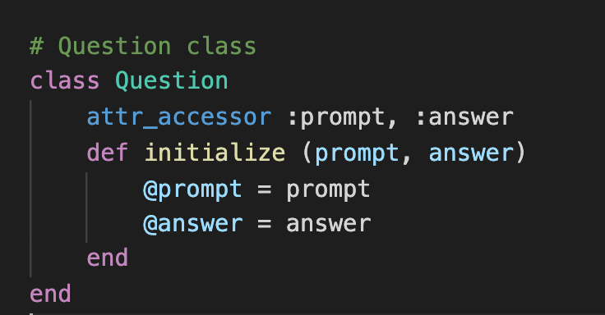
How is code organised?
Add more details here from video

Slide 5
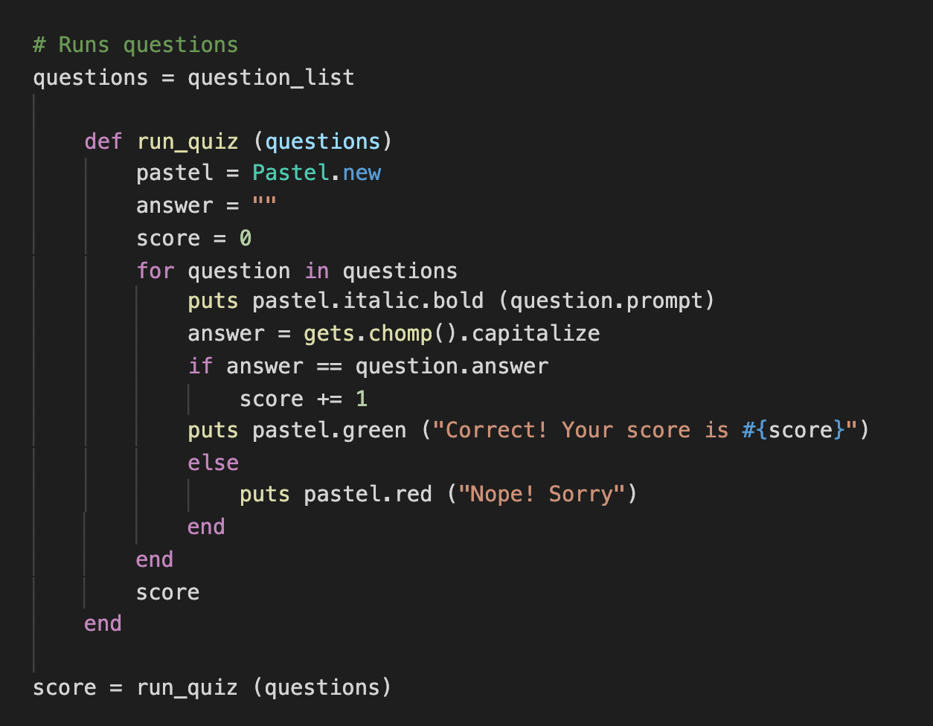
How is code organised?

Slide 6
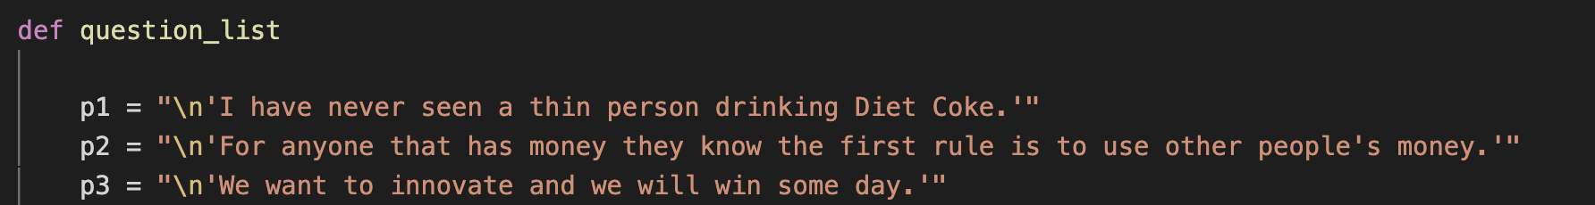
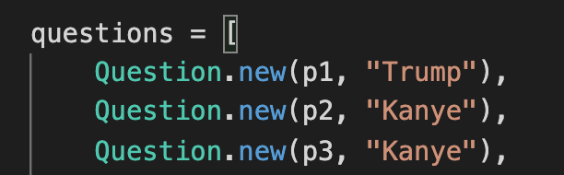
How is code organised?

Slide 7
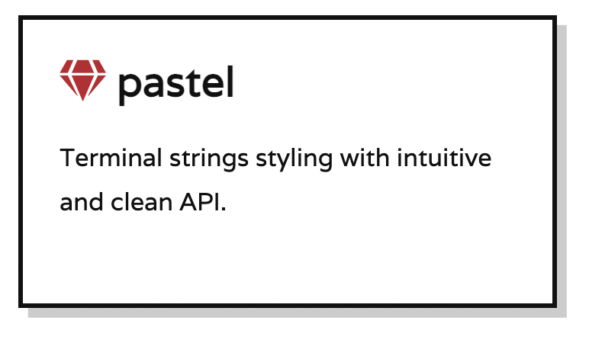
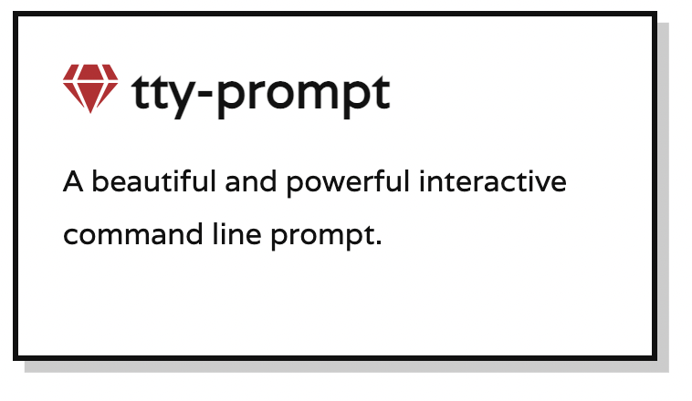
What Gems are used?
Colours, bold and italic are used to improve user experience
Users can choose Yes or No at end to gamble their points on last question

Slide 8
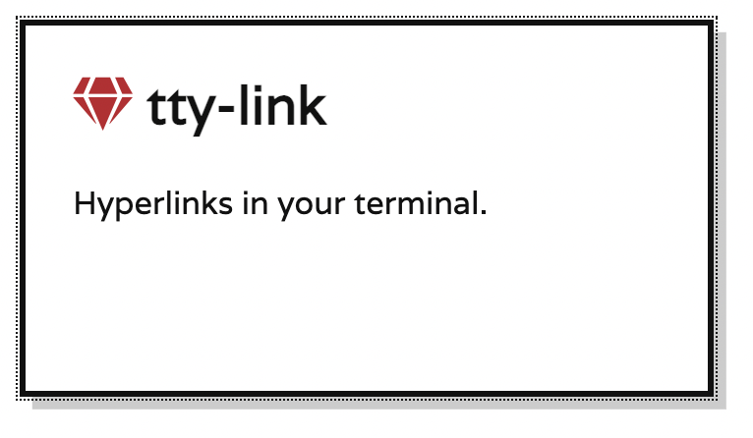
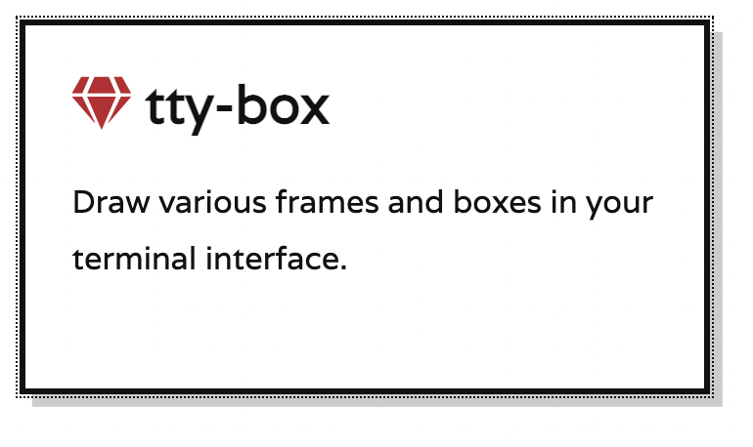
What Gems are used?
Provides link to website to give credit for content
Increased visibility for instructions, improving UX

Slide 9
Other points
Ethical issues:
Idea for quiz came from a CNN quiz, but is attributed to them in the code
Trump could get a Twitter account again making last question incorrect
As Trump doesn’t have an account any more, there is no way to verify answers being correct
Wishlist items:
Display ascii image of Trump or Kanye, depending on who the user entered for answers more often
Store user scores
Most enjoyable part?
Working out how to improve the user experience to make the app easy to understand and use

Slide 10
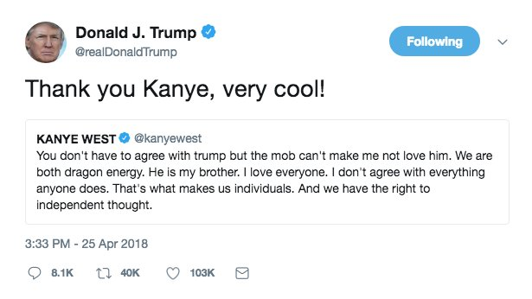
Dragon energy…

